Slide 1
TASK – 2 : Superstore Sales Data Analysis
Name – Kritee
Date – 23 September , 2025
Task title – Data Visualization and Story Storytelling
Tools Used : Jupyter notebook, Dummy Superstore Dataset of US from Kaggle

Slide 2
Introduction Dataset used : Superstore Entries Dummy dataset downloaded from Kaggle Goal : To analyze the data and provide insights using data visualization The dataset used is a superstore sales dataset. It contains records of customer orders from a retail company. The dataset depicts how a superstore performs across different products, categories, customers, regions, and shipping modes.
Order Details | Order Id, Order Date, Ship Date, Ship Mode
Customer Details | Customer Id, Name , Segment, region, City, State
Product Details | Category, Sub—category, Product Name, Product ID
Transaction Details | Sales amount

Slide 3
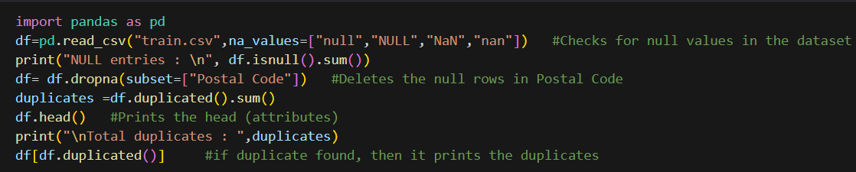
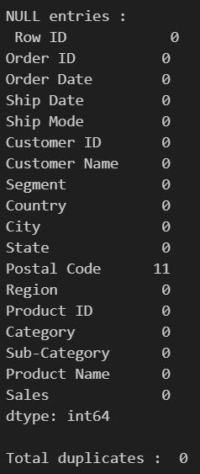
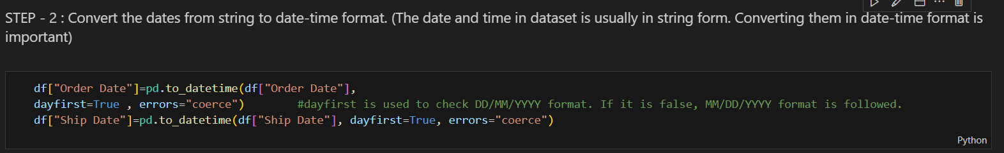
DATA PREPRATION TO USE FOR
DATA VISUALIZATION
Data Analyzation:
Data
Cleaning :
Data
Head :
Data
Formatting :

Slide 4
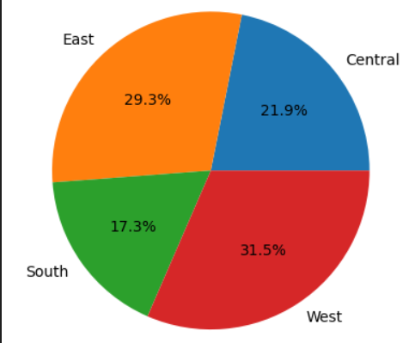
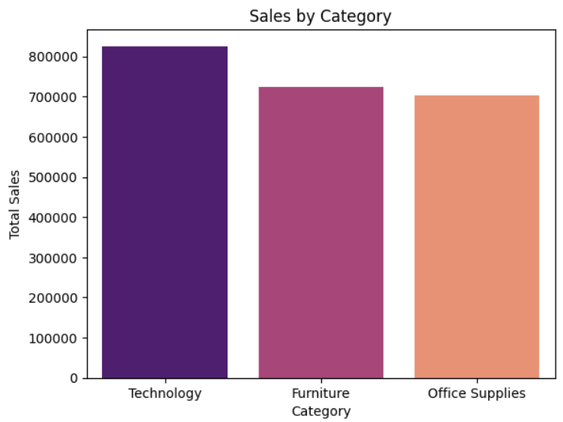
Visualization and Storytelling
Sales Distribution By Region
Sales Distribution based on
category of furniture
Fig 1 : West contributes the highest in terms of sales,
While South contributes the lowest
Fig 2 :Technology dominates the sales distribution,
While office supplies contributes the lowest

Slide 5
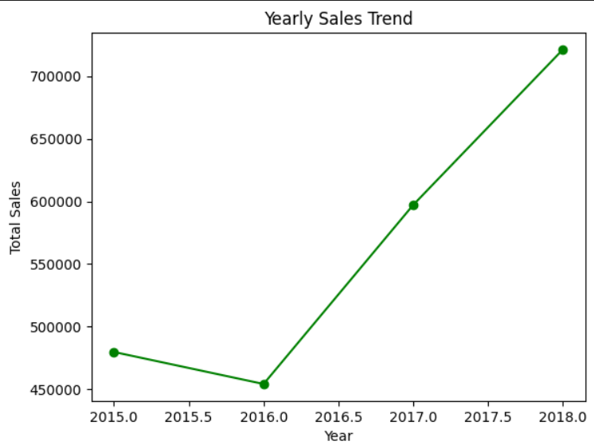
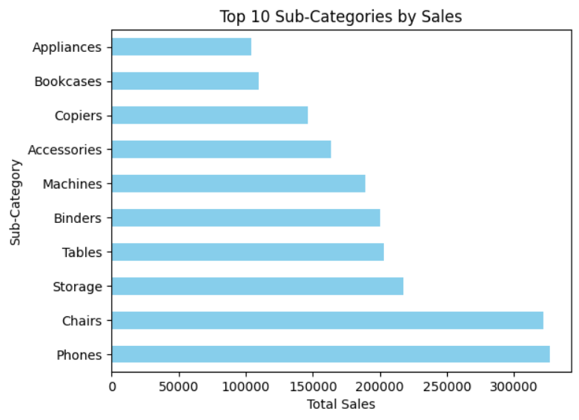
Sales Trend over Years
Top 10 sub-categories by sales
Fig 4 : Phones and Chairs lead the sales in market
Fig 3 : The sales trend has steady growth post 2016.

Slide 6
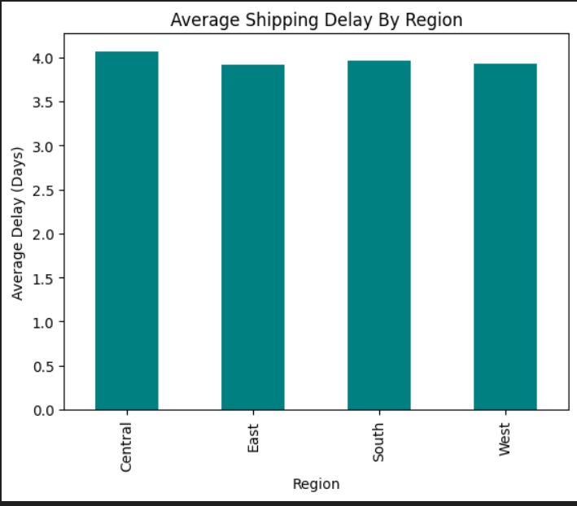
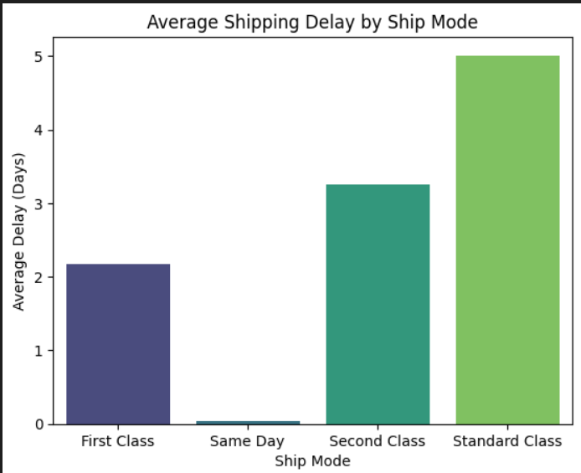
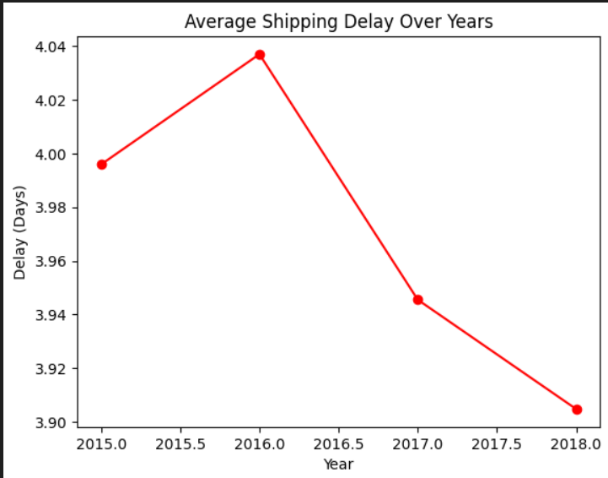
Shipping Delays :
Fig 5 : The shipment delay between different regions is almost same indicating same efficient delivery routes all over the regions.
Fig 6 : Same Day shipments were the fastest with almost 0–1-day delay. First and second-class shipments took a moderate amount of time. Standard class showed highest delay. Therefore, Standard class can be optimized to reduce wait times.
Fig 7 : In pre 2016 years, the delays were slightly higher. Over the period, trend shows steady decrease in delays.
Decreasing delays reflects operational improvements in the company’s logistics.
If delays increase, it reflects growing inefficiencies in company’s network/ signals or rising order volumes.

Slide 7
CONCLUSION
Sales perspective :
While ‘Technology’ leads overall sales followed by ‘Furniture’, Phones and Chairs are the top performing sub categories. Regionally, Some areas outperform others, Suggesting uneven business opportunities. Sales have grown steady year by year, showcase strong market expansion. The average shipping delay analysis shows that faster shipping modes (same day, First Class) are effective, as for standard class, delays can be reduced.
The yearly delay trend indicates how logistics performance has evolved, highlighting areas for improvement.
Sales have grown steadily year by year, showcasing strong market expansion.
Overall Insights :
The company has achieved significant growth driven by technology and certain sub-categories, It still faces challenges in shipping efficiency and dependency on limited products. To ensure sustainable growth, the focus should be on diversifying product performance, balancing regional sales, and reducing delays in standard class shipments.

